Slide 1

Basic Python syntax.
Comments in Python
Triple, double and single quotes
String inside the quotes
Escape sequence in Python
String concatenation
Indentation

Slide 2
Comment in python
Python, there are two types of comments
--one is a single-line comment and the other is multiline comment.
For a single-line comment, # is used
while for a multiline comment ,triple quotes """ are used:
Ex: print ("Hello World" )#This is a single comment in Python
""" For multi-line comment use three double quotes..."""
print ("Hello World!")

Slide 3
String inside the quotes
For printing a string, either a pair of single (' ') quotes or pair of double quotes (" ") can be used as shown in the succeeding
examples: print ("Hello World 'Mr' Bond")
print ('old world "but" still good')

Slide 4
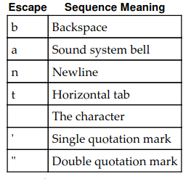
Escape sequence in Python

Slide 5
String concatenation
Two strings can be joined using the + operator
print ("Only way to join" + "two strings")

Slide 6

Indentation
The most unique characteristic of Python, unlike other programming languages, is indentation.
Indentation not only makes Python code readable, but also distinguishes each block of code from the other.
Example: If x>5:
Print("hello")

